Slide 1
Infrastructure as Code: ARM Templates
Erick Moore, Sr Cloud Solution Architect @ Microsoft

Slide 2
Agenda
ARM Foundation
Understanding ARM
JSON High Level Overview
Declarative vs Imperative
Idempotence and Deployment Modes
Sections of an ARM Template (Schema)
Parameters
Variables
Resources
Outputs
ARM Template Authoring
Template Reference
Template API Reference
GitHub Quickstart
Portal Export
Template from Scratch
Pros/Cons

Slide 3
ARM Template Foundation

Slide 4
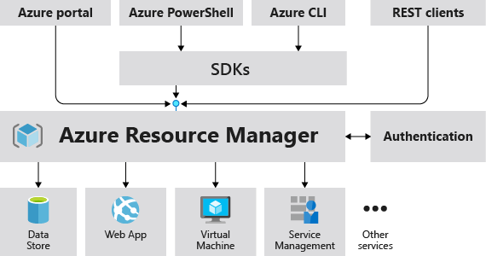
Understanding ARM
The Azure Resource Manager (ARM) is the deployment and management service for Azure.
All requests are handled by the same API providing consistent results regardless of the tools used to deploy
ARM Terminology
Resource (manageable item in Azure)
Resource Group (container holding resources)
Resource Manager Template (JSON file defining one or more resources to deploy)
Declarative Syntax (define intention without sequencing commands to create)
Notes:
Imperative code: this is how we will build the finance app
Declarative code: we are building a finance app
Imagine someone giving you imperative instructions to get to their house.
Go to the garage.
Get in your car.
Start the car. (oops, you didn’t say open the garage before starting the car, and
Turn left on Main street.
Go 10 miles, and then turn right on Cobblestone
Go to the third house on the left at 2242 Cobblestone.

Slide 5
JSON High Level Overview
JSON = Java Script Object Notation
JSON was built to store and exchange information as text and is written as key/value pairs
JSON syntax is derived from JavaScript object notation syntax
Key name (in double quotes), followed by a colon, followed by a value
Curly braces hold objects
Data is separated by commas
Square brackets hold arrays
You can have arrays of objects
“firstName”: “Erick”
“fullName”: { “firstName”: “Erick” }
“fullName”: { “firstName”: “Erick”, “lastName”: “Moore }
“cities”: [ “Indianapolis”, “Boston” ]
“cities”: [
{
“name”: “Indianapolis”,
“location“: “Midwest”
},
{
“name”: “Boston”,
“location“: “East Coast”
}
]

Slide 6
Declarative vs Imperative
Imperative Code (HOW)
Declarative Code (WHAT)
Defines specific commands required to reach a desired state, and the order and understanding of each command is critical.
Defines desired state, and the details about how that is achieved are largely irrelevant.
“We need a new environment for a financial application.”
“We need a new environment for a financial application.”
New-AzVirtualNetwork $financeNetwork
New-AzAvailabilitySet $appAS
New-AzVM $appVM01
New-AzVM $appVM02
New-AzAvailabilitySet $sqlAS
New-AzVM $sqlVM01
New-AzVM $sqlVM02
New-AzWebApp $webApp
financeAppTemplate.json
Notes:
Imperative code: this is how we will build the finance app
Declarative code: we are building a finance app
Imagine someone giving you imperative instructions to get to their house.
Go to the garage.
Get in your car.
Start the car. (oops, you didn’t say open the garage before starting the car, and
Turn left on Main street.
Go 10 miles, and then turn right on Cobblestone
Go to the third house on the left at 2242 Cobblestone.

Slide 7
Idempotence and Deployment Modes
ARM idempotence
Make the same call repeatedly and get the same result
Resources that already exist will not be re-deployed if they are defined in the template
Resources in the template will not be modified if they are unchanged
ARM templates deployment modes
Complete (only deploy or modify what is in the template, remove undefined resources)
BE CAREFUL
Incremental (only deploy or modify what is in the template, leave existing resources unchanged)
Validate (submit template to ARM for validation)

Slide 8
Sections of an ARM Template

Slide 9
ARM Template Schema
{
"$schema": "https://schema.management.azure.com/schemas/2015-01-01/deploymentTemplate.json#",
"contentVersion": "1.0.0.0",
"parameters": {},
"variables": {},
"resources": [],
"outputs": {}
}

Slide 10
ARM Template Schema: Parameters
{
"$schema": "https://schema.management.azure.com/schemas/2015-01-01/deploymentTemplate.json#",
"contentVersion": "1.0.0.0",
"parameters": {},
"variables": {},
"resources": [],
"outputs": {}
}
Parameters are values that are passed to the template at the time of deployment
These are things that you may want to change in the template
Examples: Environment, Size of Resource, Quantity, etc.

Slide 11
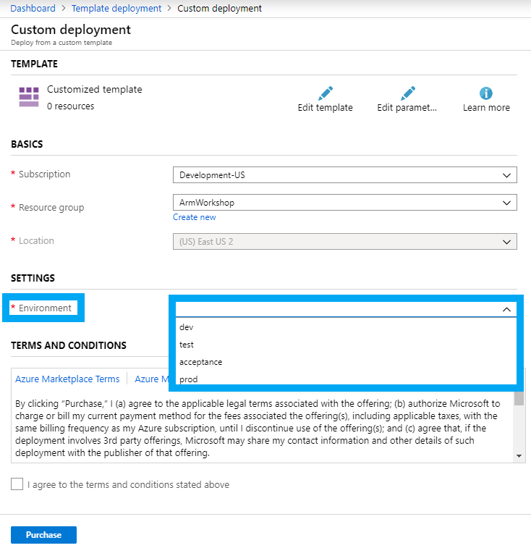
ARM Template Schema: Parameters
{
"$schema": "https://schema.management.azure.com/schemas/2015-01-01/deploymentTemplate.json#",
"contentVersion": "1.0.0.0",
"parameters": {
“environment”: {
“allowedValues”: [
“dev”,
“test”,
“acceptance”,
“prod”
],
“type”: “string”
}
},
"variables": {},
"resources": [],
"outputs": {}
}

Slide 12
ARM Template Schema: Parameter Elements
{
"$schema": "https://schema.management.azure.com/schemas/2015-01-01/deploymentTemplate.json#",
"contentVersion": "1.0.0.0",
"parameters": {
“environment”: {
“allowedValues”: [
“dev”,
“test”,
“acceptance”,
“prod”
],
“type”: “string”
}
},
"variables": {},
"resources": [],
"outputs": {}
}
Element name | Required
parameter-name | Yes
type | Yes
defaultValue | No
allowedValues | No
minValue | No
maxValue | No
minLength | No
maxLength | No
description | No

Slide 13
ARM Template Schema: Variables
{
"$schema": "https://schema.management.azure.com/schemas/2015-01-01/deploymentTemplate.json#",
"contentVersion": "1.0.0.0",
"parameters": {},
"variables": {},
"resources": [],
"outputs": {}
}
Variables are values that are hard coded into the template
Variables can be constructed from parameters or other variables
Examples: Naming conventions, template deployment options, etc.

Slide 14
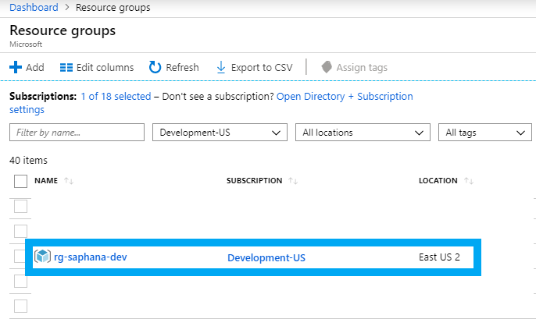
ARM Template Schema: Variables
{
"$schema": "https://schema.management.azure.com/schemas/2015-01-01/deploymentTemplate.json#",
"contentVersion": "1.0.0.0",
"parameters": {},
"variables": {
"resourceGroupName": "[concat('rg-', parameters('rgName'), '-', parameters('environment'))]"
},
"resources": [],
"outputs": {}
}

Slide 15
ARM Template Schema: Resources
{Microsoft.Network/virtualNetworks}
{Microsoft.Network/natGateways}
{Microsoft.Network/publicIPAddresses}
{Microsoft.Network/networkInterfaces}
{Microsoft.Network/privateEndpoints}
{Microsoft.Network/redirectMaps}
{Microsoft.Network/loadBalancers}
{Microsoft.Network/networkSecurityGroups}
{Microsoft.Network/applicationSecurityGroups}
{Microsoft.Network/serviceEndpointPolicies}
{Microsoft.Network/networkIntentPolicies}
{Microsoft.Network/routeTables}
{Microsoft.Network/publicIPPrefixes}
{Microsoft.Network/ddosCustomPolicies}
{Microsoft.Network/networkWatchers}
{Microsoft.Network/networkWatchers/connectionMonitors}
{Microsoft.Network/networkWatchers/lenses}
{Microsoft.Network/networkWatchers/pingMeshes}
{Microsoft.Network/virtualNetworkGateways}
{Microsoft.Network/localNetworkGateways}
{Microsoft.Network/connections}
{Microsoft.Network/applicationGateways}
{Microsoft.Network/applicationGatewayWebApplicationFirewallPolicies}
{Microsoft.Network/operationResults}
{Microsoft.Network/CheckDnsNameAvailability}
{Microsoft.Network/usages}
{Microsoft.Network/virtualNetworkAvailableEndpointServices}
{Microsoft.Network/availableDelegations}
{Microsoft.Network/serviceTags}
{Microsoft.Network/availablePrivateEndpointTypes}
{Microsoft.Network/checkPrivateLinkServiceVisibility}
{Microsoft.Network/autoApprovedPrivateLinkServices}
{Microsoft.Network/supportedVirtualMachineSizes}
{Microsoft.Network/checkAcceleratedNetworkingSupport}
{Microsoft.Network/validateResourceOwnership}
{Microsoft.Network/setResourceOwnership}
{Microsoft.Network/effectiveResourceOwnership}
{Microsoft.Network/dnszones}
{Microsoft.Network/dnsOperationResults}
{Microsoft.Network/dnsOperationStatuses}
{Microsoft.Network/getDnsResourceReference}
{Microsoft.Network/internalNotify}
{Microsoft.Network/dnszones/A}
{Microsoft.Network/dnszones/AAAA}
{Microsoft.Network/dnszones/CNAME}
{Microsoft.Network/dnszones/PTR}
{Microsoft.Network/dnszones/MX}
{Microsoft.Network/dnszones/TXT}
{Microsoft.Network/dnszones/SRV}
{Microsoft.Network/dnszones/SOA}
{Microsoft.Network/dnszones/NS}
{Microsoft.Network/dnszones/CAA}
{Microsoft.Network/dnszones/recordsets}
{Microsoft.Network/dnszones/all}
{Microsoft.Network/privateDnsZones}
{Microsoft.Network/privateDnsZones/virtualNetworkLinks}
{Microsoft.Network/privateDnsOperationResults}
{Microsoft.Network/privateDnsOperationStatuses}
{Microsoft.Network/privateDnsZones/A}
{Microsoft.Network/privateDnsZones/AAAA}
{Microsoft.Network/privateDnsZones/CNAME}
{Microsoft.Network/privateDnsZones/PTR}
{Microsoft.Network/privateDnsZones/MX}
{Microsoft.Network/privateDnsZones/TXT}
{Microsoft.Network/privateDnsZones/SRV}
{Microsoft.Network/privateDnsZones/SOA}
{Microsoft.Network/privateDnsZones/all}
{Microsoft.Network/trafficmanagerprofiles}
{Microsoft.Network/trafficmanagerprofiles/heatMaps}
{Microsoft.Network/checkTrafficManagerNameAvailability}
{Microsoft.Network/trafficManagerUserMetricsKeys}
{Microsoft.Network/trafficManagerGeographicHierarchies}
{Microsoft.Network/expressRouteCircuits}
{Microsoft.Network/expressRouteServiceProviders}
{Microsoft.Network/applicationGatewayAvailableWafRuleSets}
{Microsoft.Network/applicationGatewayAvailableSslOptions}
{Microsoft.Network/applicationGatewayAvailableServerVariables}
{Microsoft.Network/applicationGatewayAvailableRequestHeaders}
{Microsoft.Network/applicationGatewayAvailableResponseHeaders}
{Microsoft.Network/routeFilters}
{Microsoft.Network/bgpServiceCommunities}
{Microsoft.Network/virtualWans}
{Microsoft.Network/vpnSites}
{Microsoft.Network/virtualHubs}
{Microsoft.Network/vpnGateways}
{Microsoft.Network/secureGateways}
{Microsoft.Network/nfvOperations}
{Microsoft.Network/nfvOperationResults}
{Microsoft.Network/azureFirewalls}
{Microsoft.Network/azureFirewallFqdnTags}
{Microsoft.Network/virtualNetworkTaps}
{Microsoft.Network/privateLinkServices}
{Microsoft.Network/ddosProtectionPlans}
{Microsoft.Network/networkProfiles}
{Microsoft.Network/frontdoorOperationResults}
{Microsoft.Network/checkFrontdoorNameAvailability}
{Microsoft.Network/frontdoors}
{Microsoft.Network/frontdoorWebApplicationFirewallPolicies}
{Microsoft.Network/frontdoorWebApplicationFirewallManagedRuleSets}
{Microsoft.Network/webApplicationFirewallPolicies}
{Microsoft.Network/bareMetalTenants}
{Microsoft.Network/bastionHosts}
{
"$schema": "https://schema.management.azure.com/schemas/2015-01-01/deploymentTemplate.json#",
"contentVersion": "1.0.0.0",
"parameters": {},
"variables": {},
"resources": [],
"outputs": {}
}
Azure resources that will be created (storage, VMs, networks, functions, etc.)
Instantiated by ARM leveraging Azure resource providers
Many available resource providers example: Microsoft.Network

Slide 16
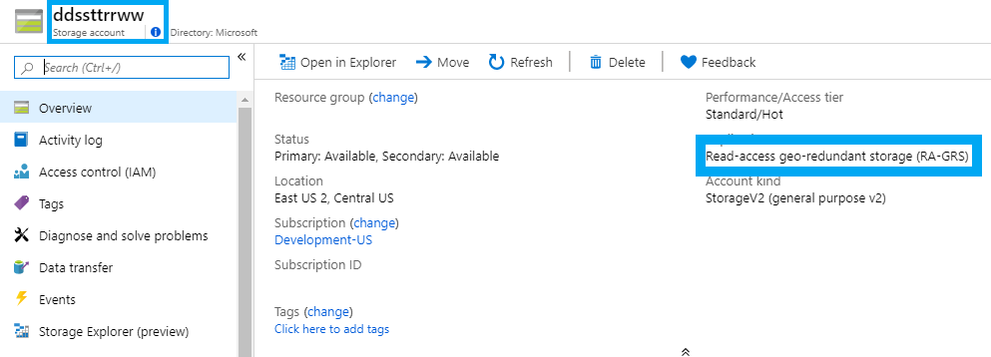
ARM Template Schema: Resources
{
"$schema": "https://schema.management.azure.com/schemas/2015-01-01/deploymentTemplate.json#",
"contentVersion": "1.0.0.0",
"parameters": {},
"variables": {},
"resources": [
{
"name": “ddssttrrww",
"type": "Microsoft.Storage/storageAccounts",
"apiVersion": "2015-06-15",
"location": "[resourceGroup().location]",
"properties": {
"accountType": “RA_GRS"
}
}
],
"outputs": {}
}

Slide 17
ARM Template Schema: Resource Elements
Element name | Required
condition | No
apiVersion | Yes
type | Yes
name | Yes
location | Varies
tags | No
comments | No
copy | No
dependsOn | No
properties | No
sku | No
kind | No
plan | No
resources | No
{
"$schema": "https://schema.management.azure.com/schemas/2015-01-01/deploymentTemplate.json#",
"contentVersion": "1.0.0.0",
"parameters": {},
"variables": {},
"resources": [],
"outputs": {}
}

Slide 18
ARM Template Schema: Outputs
{
"$schema": "https://schema.management.azure.com/schemas/2015-01-01/deploymentTemplate.json#",
"contentVersion": "1.0.0.0",
"parameters": {},
"variables": {}
"resources": [],
"outputs": {}
}
Used to exchange data between resources in a template
Example 1: create a public IP and pass that resource ID to a public load balancer
Example 2: Create a naming template and pass resource names to deployment template

Slide 19
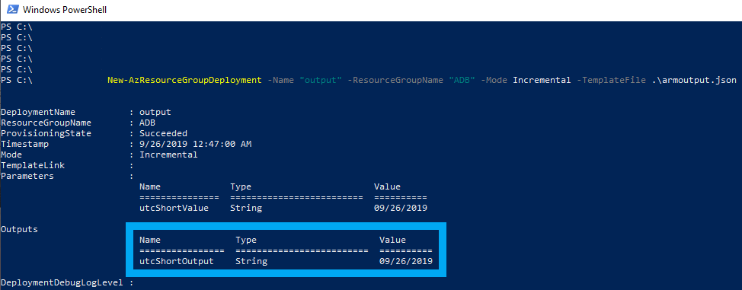
ARM Template Schema: Outputs
{
"$schema": "https://schema.management.azure.com/schemas/2015-01-01/deploymentTemplate.json#",
"contentVersion": "1.0.0.0",
"parameters": {
"utcShortValue": {
"type": "string",
"defaultValue": "[utcNow('d')]"
}
},
"variables": {},
"resources": [],
"outputs": {
"utcShortOutput": {
"type": "string",
"value": "[parameters('utcShortValue')]"
}
}
}

Slide 20
ARM Template Authoring

Slide 21
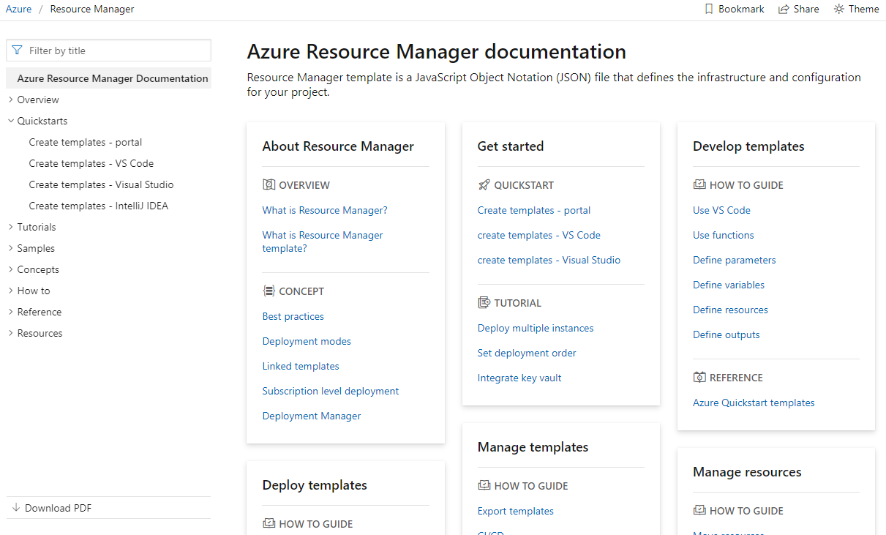
ARM Template Reference
https://docs.microsoft.com/en-us/azure/azure-resource-manager/
Best practice guides
How to and getting started step-by-step
Simple and complex templates
ARM Template functions with examples
Constantly updated with current information

Slide 22
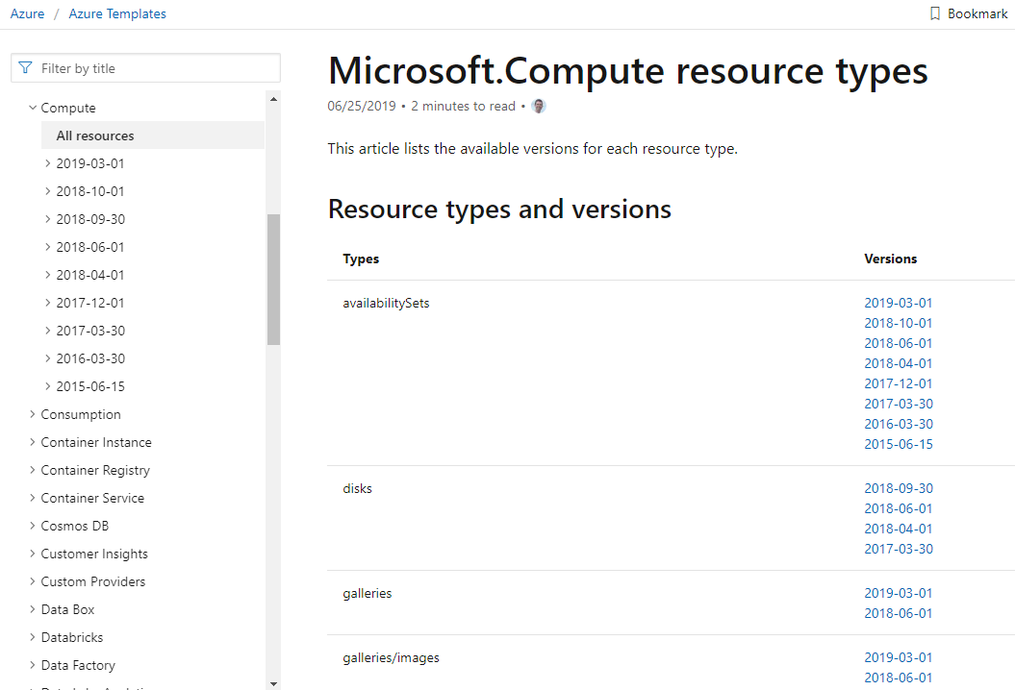
ARM Template API Reference
https://docs.microsoft.com/en-us/azure/templates/
Full list of available resource API’s
Types of resources per-provider with current and historical API’s
Break down of required and optional elements
Copy/paste code
Push button deployments into Azure Portal

Slide 23
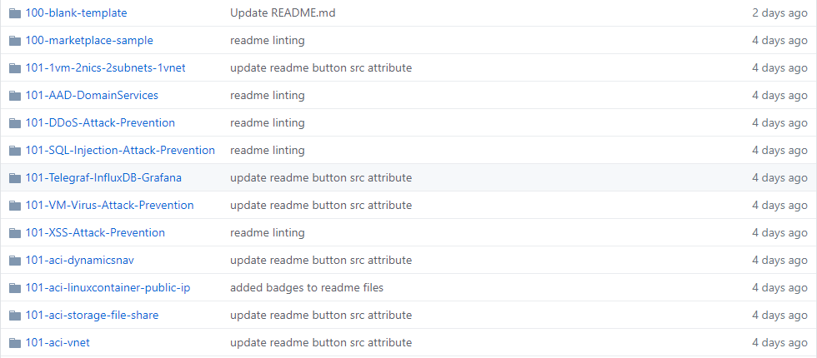
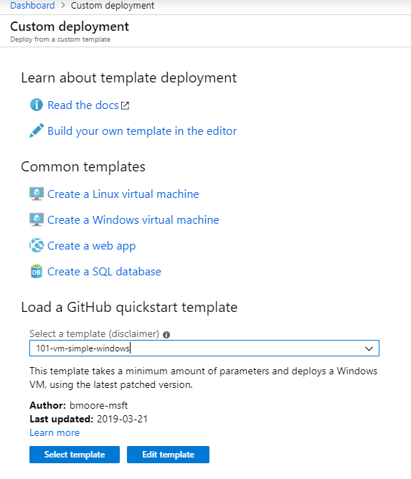
ARM Template GitHub Quickstart
https://github.com/Azure/azure-quickstart-templates
Available to deploy from GitHub
Also available to deploy from the Azure Portal
Hundreds of pre-built example templates
Great starting point for common deployment scenarios

Slide 24
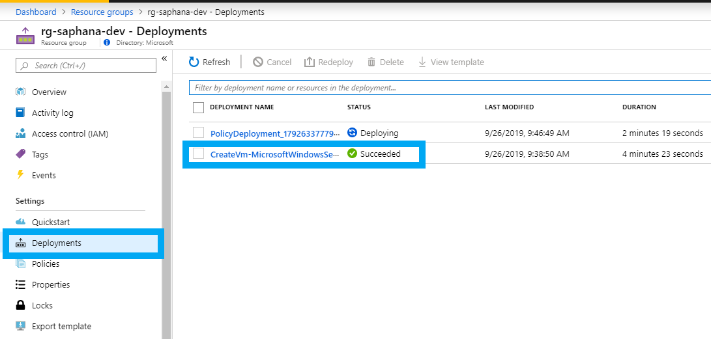
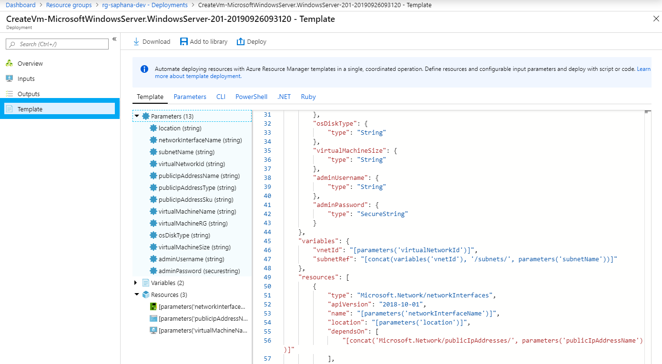
ARM Template Portal Export
View all deployments to a Resource Group
Drill in for detail about the deployment
Export, edit, or re-deploy the template

Slide 25
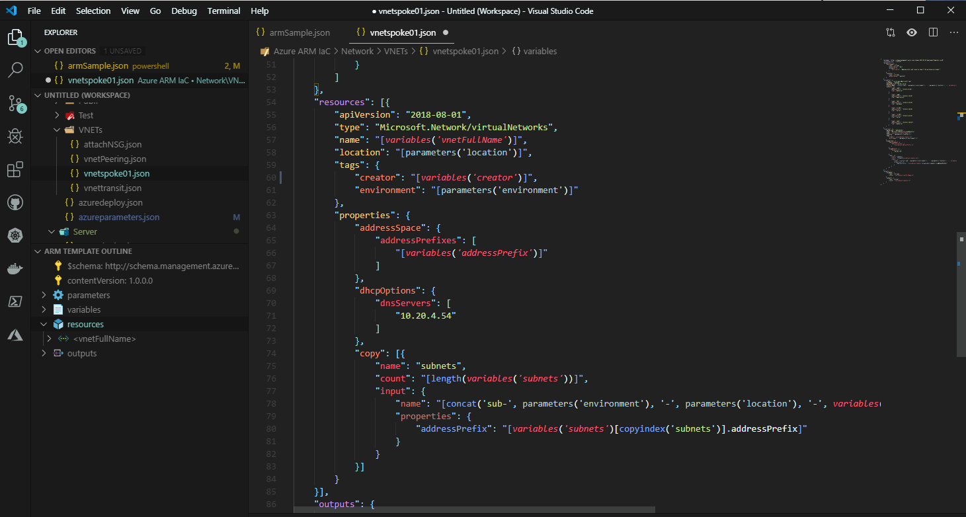
ARM Template From Scratch
Build advanced templates for entire environments
Standardize names, tags, locations, etc.
Leverage VS Code + Extensions + Snippets to ease creation
Can start with GitHub or exported templates as building blocks
Link template creation to Agile processes and DevOps workflows

Slide 26
ARM Template Authoring Pros/Cons
GitHub Quickstart Pros | Portal Export Pros | New Template Pros
Easy to read | Identical to what you requested | Identical to what you requested
Options for almost all Azure Resources | Familiar for GUI users | Templates will be lightweight
Good starting point for understanding ARM templates | Good starting point for understanding ARM templates | Can build advanced environments (many different resources in a single or group of templates)
GitHub Quickstart Cons | Portal Export Cons | New Template Cons
Very lightweight and may need more properties added for resources | Lots of clean up to do in the template to make it readable and remove unnecessary items | Harder for new users to get started
May or may not use current API | Results in very large templates (no support for copy loops) | Very development like (make a change, try it, fail, change and try again until it works)
Need heavy modification for entire environment deployments | Template output can be confusing

